Slide 1

DEPARTMENT OF ARTIFICIAL INTELLIGENCE AND DATA SCIENCE
Vision
To impart international quality education, promote collaborative research and graduate industry-ready engineers in the domain of Artificial Intelligence and Data Science to serve the society.

Slide 2
Class
It is a abstract data type
Classes are used to create user-defined data structures
Class is a logical entity that contains some attributes and methods
A class is a collection of objects.
A class contains the blueprints from which the objects are being created.

Slide 3
class Student:
# class attribute
name = ""
# Instance attribute
def __init__(self, name):
self.name = name
def displayname(self):
print("My name is {}".format(self.name))
# Object instantiation or creation
s1 = Student("Raja") # it execute constructor or init method automatically
# Accessing class methods
s1.displayname()
The __init__ method or constructor
The __init__ method is a constructors.
It is executed automatically when an object of a class is instantiated/created.
Self
self identifies the instance upon which a method is invoked

Slide 4
class Student:
# class attribute
attr1 = "RIT STUDENTS"
# Instance attribute
def __init__(self, name):
self.name = name
# Object instantiation
Student1 = Student("Raja")
Student2 = Student("Ramu")
# Accessing class attributes
print("Student1 is a {}".format(Student1.__class__.attr1))
print("Student2 is also a {}".format(Student2.__class__.attr1))
# Accessing instance attributes
print("Student1 name is {}".format(Student1.name))
print("Student2 name is {}".format(Student2.name))
Output
Student1 is a RIT STUDENTS
Student2 is also a RIT STUDENTS
Student1 name is Raja
Student2 name is Ramu

Slide 5
Practices
Create a class called car and its attributes are model and color. Create a function to display the car attributes.
2 Create a class called dog and its attribute is species. Create a function description() that returns a string displaying the name and age of the dog. Create a another function speak() has one parameter called sound that returns a string containing the dog’s name and the sound the dog makes.
3 Create a class called book and its attributes are title, quantity, author and price . Create a function display to print the book details.

Slide 6
class car():
# init method or constructor
def __init__(self, model, color):
self.model = model
self.color = color
def show(self):
print("Model is", self.model )
print("color is", self.color )
# both objects have different self which
# contain their attributes
audi = car("audi a4", "blue")
ferrari = car("ferrari 488", "green")
audi.show() # same output as car.show(audi)
ferrari.show() # same output as car.show(ferrari)

Slide 7
class Dog:
species = "Canis familiaris" # class variable
def __init__(self, name, age):
self.name = name # instance variable
self.age = age
# Instance method
def description(self):
return f"{self.name} is {self.age} years old"
# Another instance method
def speak(self, sound):
return f"{self.name} says {sound}“
# Object instantiation
d1 = Dog("Labrador", 9)
print(d1.description())
d2 = Dog(" Labrador ", 9)
print(d2.speak("wow"))
Output
Labrador is 9 years old
Labrador says wow

Slide 8
class Book:
def __init__(self, title, quantity, author, price):
self.title = title
self.quantity = quantity
self.author = author
self.price = price
def __repr__(self):
return f"Book: {self.title}, Quantity: {self.quantity}, Author:
{self.author}, Price: {self.price}"
book1 = Book('Book 1', 12, 'Author 1', 120)
book2 = Book('Book 2', 18, 'Author 2', 220)
book3 = Book('Book 3', 28, 'Author 3', 320)
print(book1)
print(book2)
print(book3)

Slide 9
practice
1. Create a class called ComplexNumber which contain two data called real and imaginary. Create a displaymethod to print the data. Delete the attribute , function and object.

Slide 10
class ComplexNumber:
def __init__(self, r=0, i=0):
self.real = r
self.imag = i
def display(self):
print(f'{self.real}+{self.imag}j')
# Create a new ComplexNumber object
cn. ComplexNumber()
cn. display() # what is the output
cn = ComplexNumber(2, 3)
# Output: 2+3j
cn. display()
del num1.imag
del ComplexNumber.display
del cn

Slide 11
class CreditCard:
"""A consumer credit card."""
def __init__(self, customer, bank, acnt, limit):
self._customer = customer
self._bank = bank
self._account = acnt
self._limit = limit
self._balance = 0

Slide 12
def get_customer(self):
"""Return name of the customer."""
return self._customer
def get_bank(self):
"""Return the bank's name."""
return self._bank
def get_account(self):
"""Return the card identifying number (typically stored as a string)."""
return self._account
def get_limit(self):
"""Return current credit limit."""
return self._limit
def get_balance(self):
"""Return current balance."""
return self._balance

Slide 13
def charge(self, price):
"""Charge given price to the card, assuming sufficient credit limit.
Return True if charge was processed; False if charge was denied. ""“
if price + self._balance > self._limit: # if charge would exceed limit,
return False # cannot accept charge
else:
self._balance += price
return True
def make_payment(self, amount):
"""Process customer payment that reduces balance."""
self._balance -= amount

Slide 14
if __name__ == '__main__':
wallet = []
wallet.append(CreditCard('John Bowman', 'California Savings',
'5391 0375 9387 5309', 2500) )
wallet.append(CreditCard('John Bowman', 'California Federal',
'3485 0399 3395 1954', 3500) )
wallet.append(CreditCard('John Bowman', 'California Finance',
'5391 0375 9387 5309', 5000) )
for val in range(1, 17):
wallet[0].charge(val)
wallet[1].charge(2*val)
wallet[2].charge(3*val)

Slide 15
for c in range(3):
print('Customer =', wallet[c].get_customer())
print('Bank =', wallet[c].get_bank())
print('Account =', wallet[c].get_account())
print('Limit =', wallet[c].get_limit())
print('Balance =', wallet[c].get_balance())
while wallet[c].get_balance() > 100:
wallet[c].make_payment(100)
print('New balance =', wallet[c].get_balance())
print()

Slide 16
class PredatoryCreditCard(CreditCard):
"""An extension to CreditCard that compounds interest and fees."""
def __init__(self, customer, bank, acnt, limit, apr):
"""Create a new predatory credit card instance.
super().__init__(customer, bank, acnt, limit) # call super constructor
self._apr = apr
def charge(self, price):
"""Charge given price to the card, assuming sufficient credit limit.
Return True if charge was processed.
Return False and assess $5 fee if charge is denied. """
success = super().charge(price) # call inherited method
if not success:
self._balance += 5 # assess penalty
return success # caller expects return value

Slide 17
Iterator
An iterator is an object that consist of the methods __iter__() and __next__(). Iterator can be iterated
mytuple = ("apple", "banana", "cherry") myit = iter(mytuple) print(next(myit)) print(next(myit)) print(next(myit))

Slide 18
class SequenceIterator:
"""An iterator for any of Python's sequence types."""
def __init__(self, sequence):
"""Create an iterator for the given sequence."""
self._seq = sequence # keep a reference to the underlying data
self._k = -1 # will increment to 0 on first call to next
def __next__(self):
"""Return the next element, or else raise StopIteration error."""
self._k += 1 # advance to next index
if self._k < len(self._seq):
return(self._seq[self._k]) # return the data element
else:
raise StopIteration() # there are no more elements
def __iter__(self):
"""By convention, an iterator must return itself as an iterator."""
return
mytuple = ("apple", "banana", "cherry")
myobj = SequenceIterator(mytuple)
print(next(myobj))
print(next(myobj))

Slide 19
Operator overloading
Operator Overloading means giving additional meaning beyond their predefined operational meaning.
For example operator +
is used to add two integers as well as
join two strings and
merge two lists.
It is achievable because ‘+’ operator is overloaded by int class and str class.

Slide 20
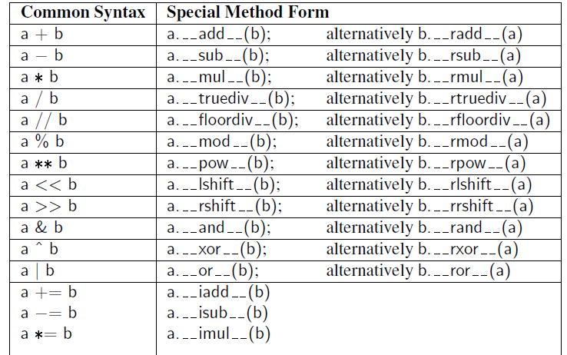

Slide 21
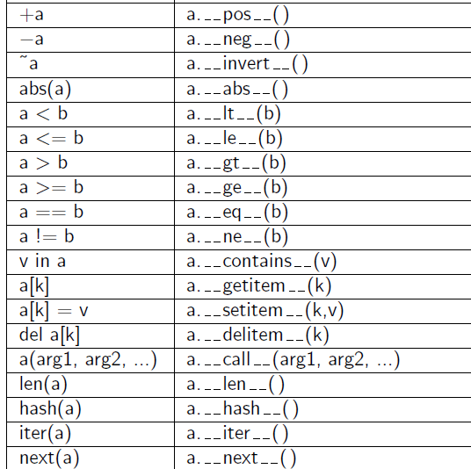

Slide 22
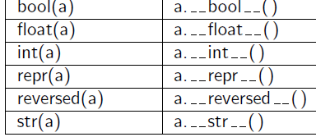

Slide 23
#operator overloading
print(1 + 2)
# concatenate two strings
print("RIT"+"IANS")
# Product two numbers
print(3 * 4)
# Repeat the String
print("RIT"*4)

Slide 24
# Python Program to overload an binary + operator
class A:
def __init__(self, a):
self.a = a
# adding two objects
def __add__(self, o):
return self.a + o.a
ob1 = A(1)
ob2 = A(2)
ob3 = A(“RIT")
ob4 = A(“IANS")
print(ob1 + ob2) # output ?
print(ob3 + ob4) # output ?

Slide 25
Python Program to perform addition of two complex numbers using binary + operator overloading.
class Complex:
def __init__(self, real, imaginary):
self. real = real
self. imaginary = imaginary
# adding two objects by operator overloading method
def __add__(self, other):
return self. real + other. real, self. imaginary + other. imaginary
Ob1 = complex(1, 2)
Ob2 = complex(2, 3)
Ob3 = Ob1 + Ob2
print(Ob3)

Slide 26
# Python program to overload a comparison operators
class A:
def __init__(self, a):
self.a = a
def __gt__(self, other):
if(self.a>other.a):
return True
else:
return False
ob1 = A(2)
ob2 = A(3)
if(ob1>ob2):
print("ob1 is greater than ob2")
else:
print("ob2 is greater than ob1")

Slide 27
Practice
Python program to overload equality and less than operators
Python program to overload not equality and greater than operators

Slide 28
EX: Operator overloading-Multi-dimensional vector class
import collections
class Vector:
"""Represent a vector in a multidimensional space."""
def __init__(self, d):
if isinstance(d, int):
self._coords = [0] * d
else:
try: # we test if param is iterable
self._coords = [val for val in d]
except TypeError:
raise TypeError('invalid parameter type')

Slide 29
def __len__(self):
"""Return the dimension of the vector."""
return len(self._coords)
def __getitem__(self, j):
"""Return jth coordinate of vector."""
return self._coords[j]
def __setitem__(self, j, val):
"""Set jth coordinate of vector to given value."""
self._coords[j] = val

Slide 30
def __add__(self, other):
"""Return sum of two vectors."""
if len(self) != len(other): # relies on __len__ method
raise ValueError('dimensions must agree')
result = Vector(len(self)) # start with vector of zeros
for j in range(len(self)):
result[j] = self[j] + other[j]
return result
def __eq__(self, other):
"""Return True if vector has same coordinates as other."""
return self._coords == other._coords

Slide 31
def __ne__(self, other):
"""Return True if vector differs from other."""
return not self == other # rely on existing __eq__ definition
def __str__(self):
"""Produce string representation of vector."""
return '<' + str(self._coords)[1:-1] + '>' # adapt list representation
def __neg__(self):
"""Return copy of vector with all coordinates negated."""
result = Vector(len(self)) # start with vector of zeros
for j in range(len(self)):
result[j] = -self[j]
return result

Slide 32
def __lt__(self, other):
"""Compare vectors based on lexicographical order."""
if len(self) != len(other):
raise ValueError('dimensions must agree')
return self._coords < other._coords
def __le__(self, other):
"""Compare vectors based on lexicographical order."""
if len(self) != len(other):
raise ValueError('dimensions must agree')
return self._coords <= other._coords

Slide 33
References
https://www.geeksforgeeks.org/python-oops-concepts/

